Slide 1






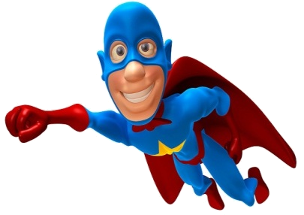


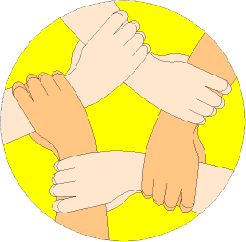
Which ones are you using?
Positive Thinker
Creative Entrepreneur
Independent Learner
Reflective Learner
Responsible Citizen
Team Worker
Enterprise Skills
LESSON OBJECTIVES
We are learning to:
Enhance our Mathematical learning skills.
(Which Enterprise skills?)
Accurately rotate objects about different centres of rotation. (Levels 5-6)
Always aim high!
Where are we in our journey?
Real life cross/curricular links?
AUTHOR

Slide 2
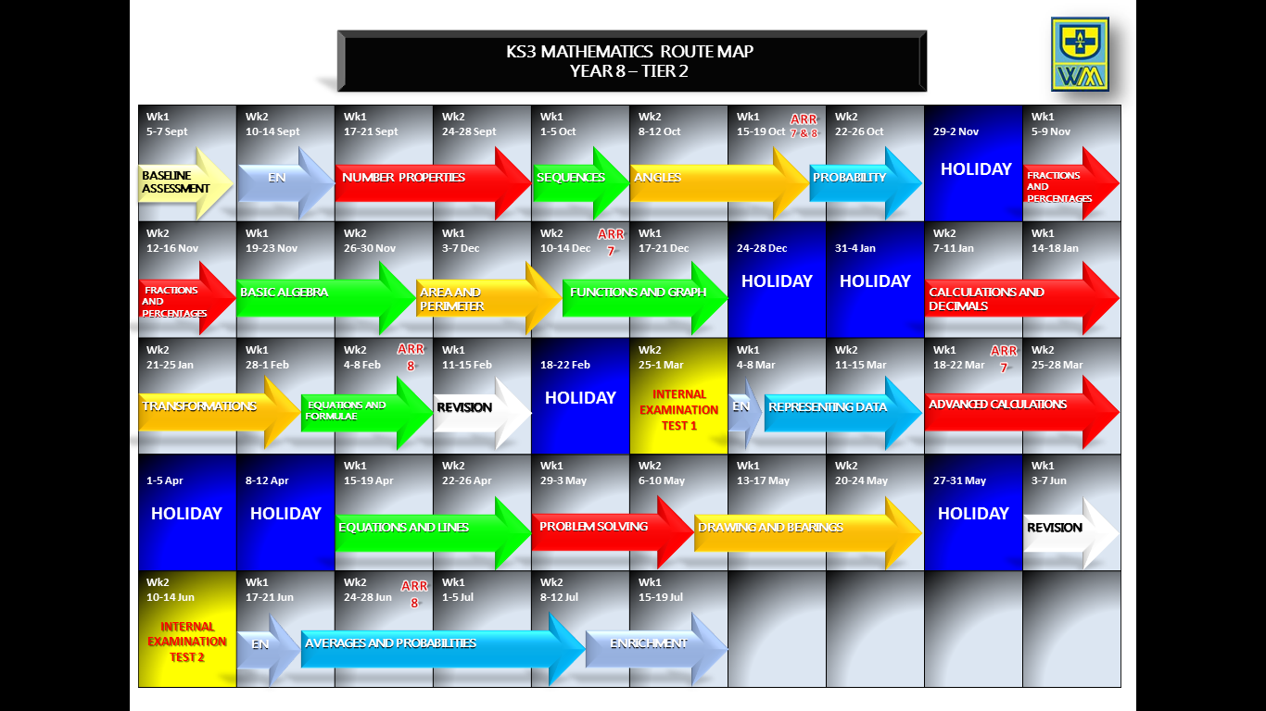
Positive Thinker
Creative Entrepreneur
Independent Learner
Reflective Learner
Responsible Citizen
Team Worker
LEARNING JOURNEY
Enterprise Skills
Which ones are you using?

Slide 3
Positive Thinker
Creative Entrepreneur
Independent Learner
Reflective Learner
Responsible Citizen
Team Worker
BRAIN IN GEAR
Enterprise Skills
Which ones are you using?
EXAMPLE
DITDIONA can be rearranged to make ADDITION
TASK
Work out the following Mathematical anagrams:
NQTUIEDISTA
BTEOCJ
GEIMA
Equidistant
Object
Image
EXTENSION
Develop your own Mathematical anagrams as above as a creative entrepreneur.

Slide 4



Positive Thinker
Creative Entrepreneur
Independent Learner
Reflective Learner
Responsible Citizen
Team Worker
STARTER
Enterprise Skills
Which ones are you using?
TASK
EXTENSION
1)
Simplify: 9b - 7c – 6b + 5c
1)
Work out without a calculator: 7.2 x 8.6
3b
=
- 2c
=
2)
Round 6.61 to 1d.p
6.6
(a)
24.29
(b)
Round 24.288 to 2d.p
=
7
2
x
3)
Value of 5d - 2 when d = -3
=
=
-17
5 x -3 - 2
-15 - 2
=
Replace d with -3
8
2
1
1
5
1
1
5
6
3 2 . 6
- 1 7 . 9 5
5 . 4 7
+ 1 4 . 9
0
4)
0
5)
1
1
6
6
0
1
1
4
1
6
2
0
.
3
7
1
4
.
6
5
1
2
2
5)
1
1
5
2
Answer = 1152
9
2
8
9 2 1 6
1
4
1
6)
6(y - 4) - 5
Expand and simplify:
=
6y
- 24
- 5
ANSWER = 61.92
6y - 29
=

Slide 5

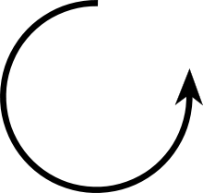

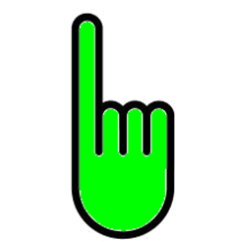
Positive Thinker
Creative Entrepreneur
Independent Learner
Reflective Learner
Responsible Citizen
Team Worker
ROTATIONS
Enterprise Skills
Which ones are you using?
INTRODUCTION
ROTATION
Turns a shape about a fixed point
Three things you need to know
1) Direction
Clockwise
Anti-clockwise
2) Angle
90°
180°
270°
360°
Quarter turn
Half turn
Three-quarters turn
Full turn
3) Centre of rotation
The point where you rotate from.

Slide 6




Positive Thinker
Creative Entrepreneur
Independent Learner
Reflective Learner
Responsible Citizen
Team Worker
ROTATIONS
Enterprise Skills
Which ones are you using?
EXAMPLES
1)
2)
O
G
Rotate this shape clockwise 90⁰ about the point O.
Rotate this shape anticlockwise180⁰ about the point G.

Slide 7
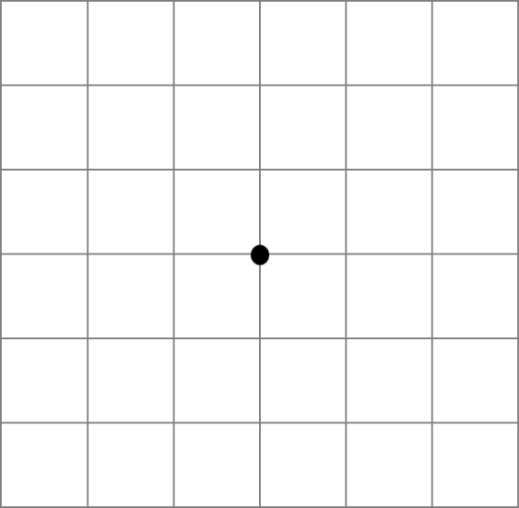
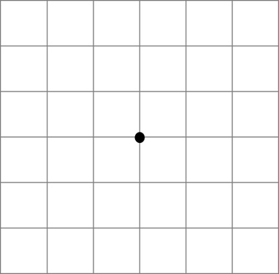


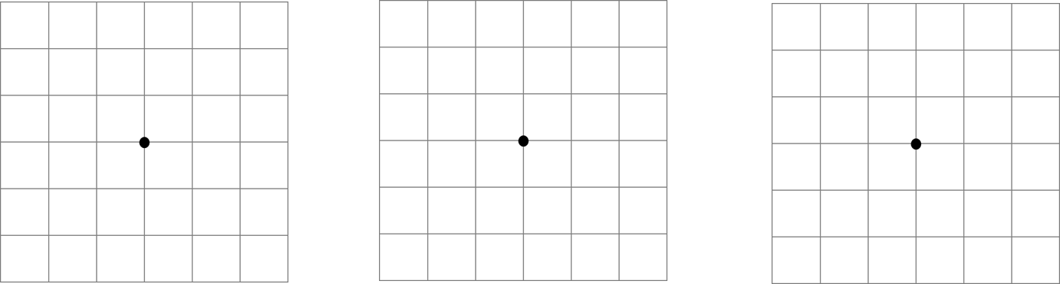



Positive Thinker
Creative Entrepreneur
Independent Learner
Reflective Learner
Responsible Citizen
Team Worker
ROTATIONS
Enterprise Skills
Which ones are you using?
TASK 1 (LEVEL 5)
1)
2)
3)
4)
5)
6)
Rotate the shape 270° clockwise

Slide 8
Positive Thinker
Creative Entrepreneur
Independent Learner
Reflective Learner
Responsible Citizen
Team Worker
ROTATIONS
Enterprise Skills
Which ones are you using?
EXTENSION 1 (LEVEL 5)
1)
2)
3)
4)
5)
6)
Rotate the shape 270° clockwise

Slide 9
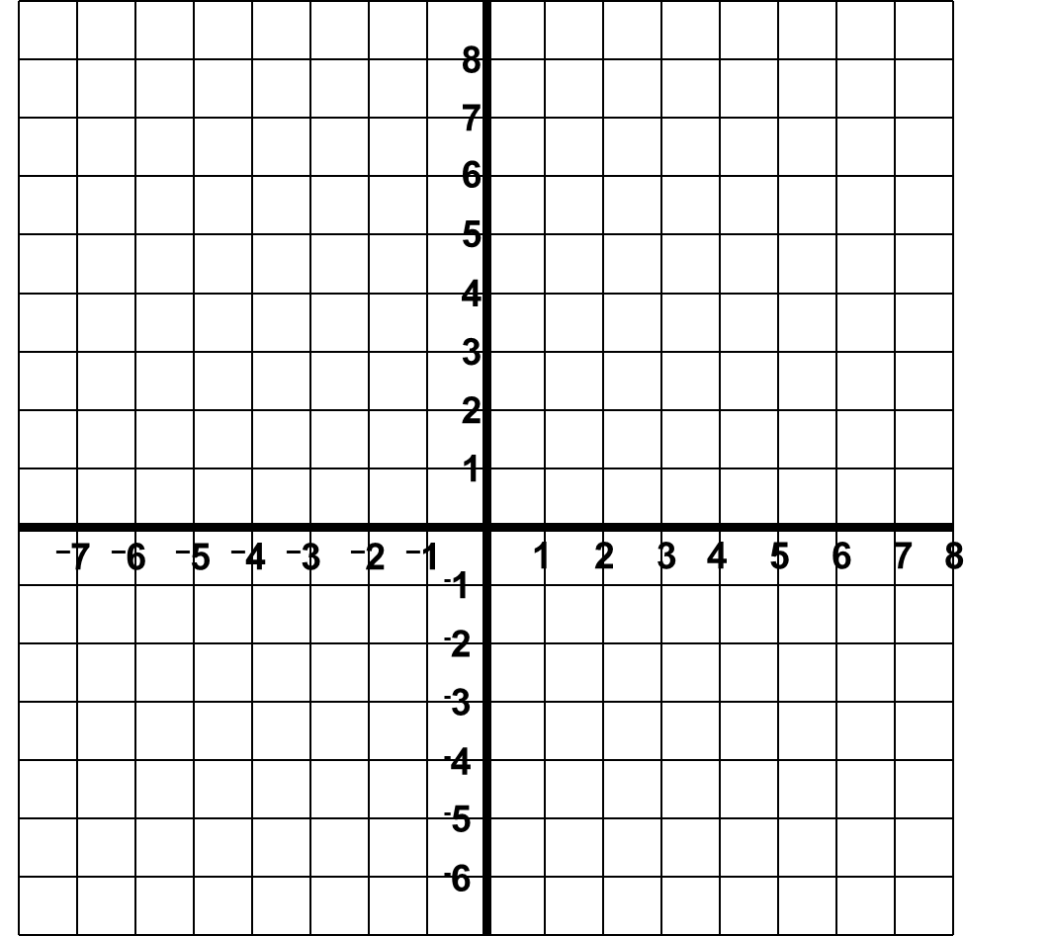
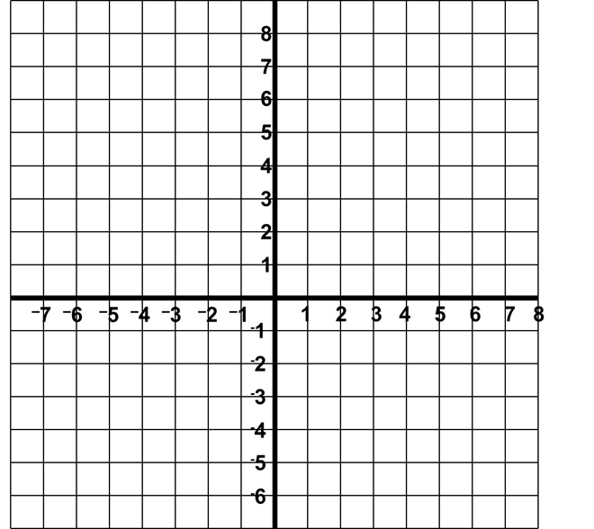
Positive Thinker
Creative Entrepreneur
Independent Learner
Reflective Learner
Responsible Citizen
Team Worker
ROTATIONS
Enterprise Skills
Which ones are you using?
EXAMPLES
3)
4)
Rotate the shape clockwise 90⁰ about the point (1,2)
Rotate this shape anticlockwise 180⁰ about the point (-3,2)

Slide 10
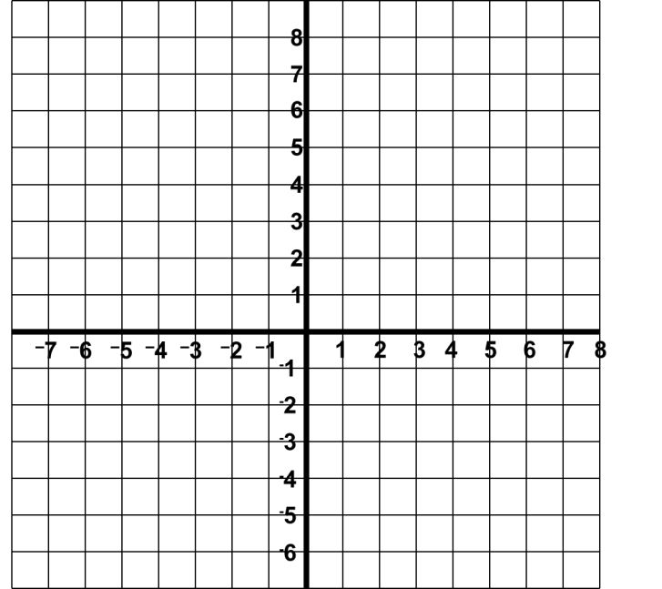
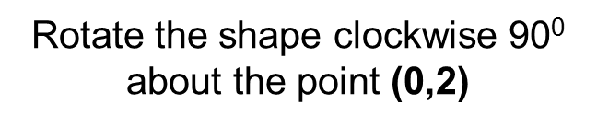
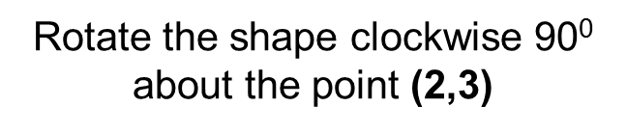
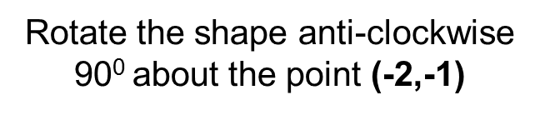
Positive Thinker
Creative Entrepreneur
Independent Learner
Reflective Learner
Responsible Citizen
Team Worker
ROTATIONS
Enterprise Skills
Which ones are you using?
TASK 2 (LEVEL 6)
1)
2)
3)
x
x
x
Rotate the shapes from the points given:

Slide 11
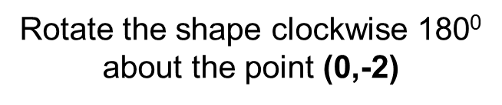
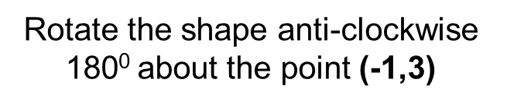
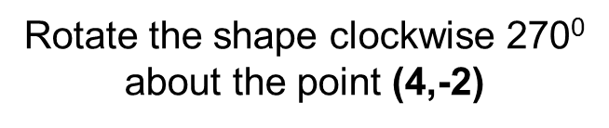
Positive Thinker
Creative Entrepreneur
Independent Learner
Reflective Learner
Responsible Citizen
Team Worker
ROTATIONS
Enterprise Skills
Which ones are you using?
TASK 2 (LEVEL 6)
4)
5)
6)
x
x
x
Rotate the shapes from the points given:

Slide 12
Positive Thinker
Creative Entrepreneur
Independent Learner
Reflective Learner
Responsible Citizen
Team Worker
ROTATIONS
Enterprise Skills
Which ones are you using?
EXTENSION 2 (LEVEL 6)
1)
2)
3)
x
x
x
Rotate the shapes from the points given:

Slide 13
Positive Thinker
Creative Entrepreneur
Independent Learner
Reflective Learner
Responsible Citizen
Team Worker
ROTATIONS
Enterprise Skills
Which ones are you using?
EXTENSION 2 (LEVEL 6)
4)
5)
6)
x
x
x
Rotate the shapes from the points given:

Slide 14
Positive Thinker
Creative Entrepreneur
Independent Learner
Reflective Learner
Responsible Citizen
Team Worker
ROTATIONS
Enterprise Skills
Which ones are you using?
EXAMPLES
5)
6)
A
B
B
x
A
Describe the transformation which takes shape A to B.
Describe the transformation which takes shape A to B.
A rotation 90° clockwise about the origin (0,0).
A rotation 180° about the point (1,3).

Slide 15
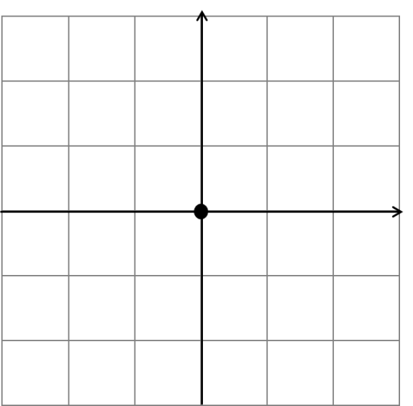
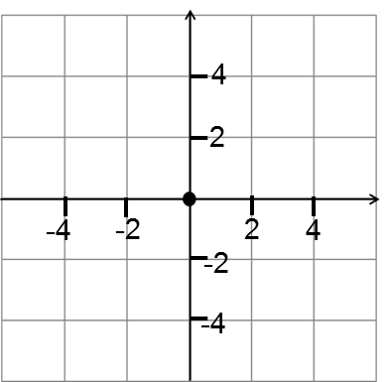
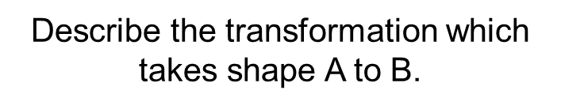

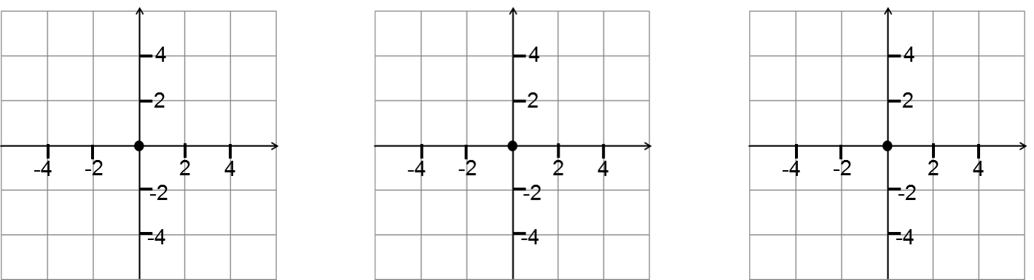
Positive Thinker
Creative Entrepreneur
Independent Learner
Reflective Learner
Responsible Citizen
Team Worker
ROTATIONS
Enterprise Skills
Which ones are you using?
TASK 3 (LEVEL 6)
1)
2)
3)
4
A
A
A
A
A
A
A
2
x
B
x
x
-4
-2
2
4
Rotation 90° clockwise about (0,0)
Rotation 180° clockwise about (0,0)
-2
B
Rotation 180° clockwise about
(-2,2)
B
-4
4)
5)
6)
A
A
B
A
A
A
A
A
x
x
x
Rotation 90° clockwise about (0,0)
B
Rotation 90° clockwise about
(-2,0)
Rotation 180° clockwise about
(1,1)
B
Rotate the shapes from the points given:

Slide 16
Positive Thinker
Creative Entrepreneur
Independent Learner
Reflective Learner
Responsible Citizen
Team Worker
ROTATIONS
Enterprise Skills
Which ones are you using?
EXTENSION 3 (LEVEL 6)
1)
2)
3)
x
x
x
x
x
x
x
x
x
x
x
Plot the co-ordinates (1,-2), (0,2), (3,2) and (3,-3) to make a shape. Rotate this shape 90° clockwise about the origin.
Plot the co-ordinates (2,0), (1,3) and (5,0) to make a shape. Rotate this shape 180° about the origin.
Plot the co-ordinates
(-1,2), (-2,0), (-4,0) and (-3,4) to make a shape. Rotate this shape 270° anti-clockwise about the origin.

Slide 17




Positive Thinker
Creative Entrepreneur
Independent Learner
Reflective Learner
Responsible Citizen
Team Worker
ROTATIONS
Enterprise Skills
Which ones are you using?
MINI-PLENARY – AFL CARDS
Which letter represents a 180° rotation of the arrow?

Slide 18


Positive Thinker
Creative Entrepreneur
Independent Learner
Reflective Learner
Responsible Citizen
Team Worker
ROTATIONS
Enterprise Skills
Which ones are you using?
MINI-PLENARY – AFL CARDS
Which letter represents a 90° clockwise rotation of the triangle?

Slide 19



Positive Thinker
Creative Entrepreneur
Independent Learner
Reflective Learner
Responsible Citizen
Team Worker
ROTATIONS
Enterprise Skills
Which ones are you using?
MINI-PLENARY – AFL CARDS
Which letter represents a 90° anti-clockwise rotation of the triangle?

Slide 20


Positive Thinker
Creative Entrepreneur
Independent Learner
Reflective Learner
Responsible Citizen
Team Worker
ROTATIONS
Enterprise Skills
Which ones are you using?
MINI-PLENARY – AFL CARDS
Which letter represents a 90° anti-clockwise rotation of the square?
X

Slide 21
Positive Thinker
Creative Entrepreneur
Independent Learner
Reflective Learner
Responsible Citizen
Team Worker
DISCOVERY
Enterprise Skills
Which ones are you using?
LINK BACK TO OBJECTIVES
Accurately rotate objects about different centres of rotation.
What level are we working at?

Slide 22
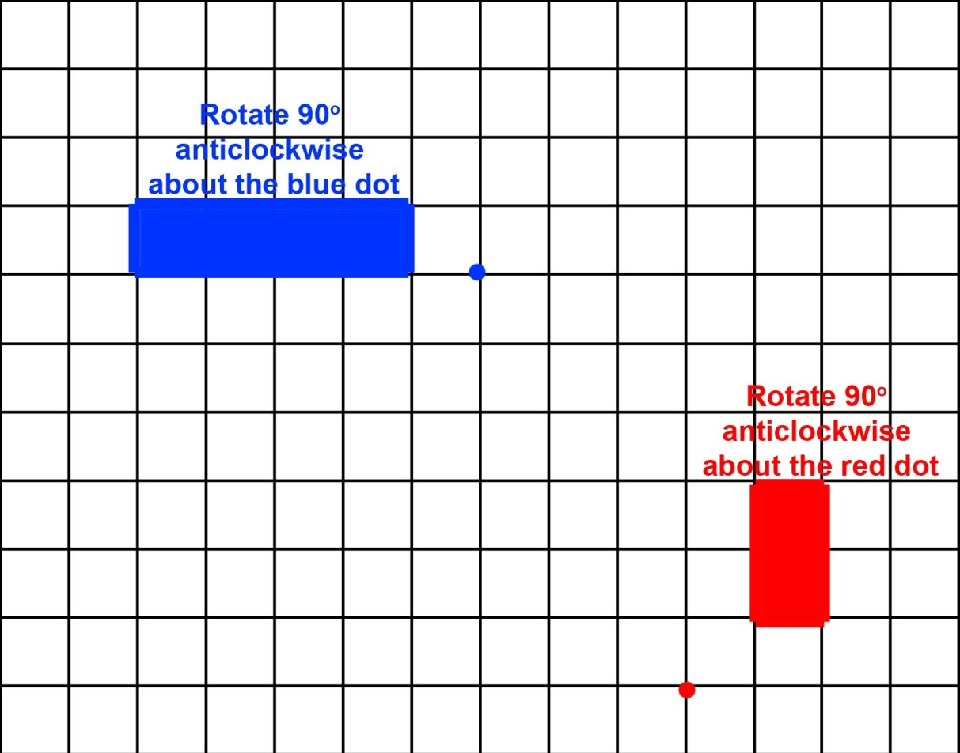
Positive Thinker
Creative Entrepreneur
Independent Learner
Reflective Learner
Responsible Citizen
Team Worker
ROTATIONS
Enterprise Skills
Which ones are you using?
PLENARY ACTIVITY
Which letter would you get if you rotated each shape as described?

Slide 23
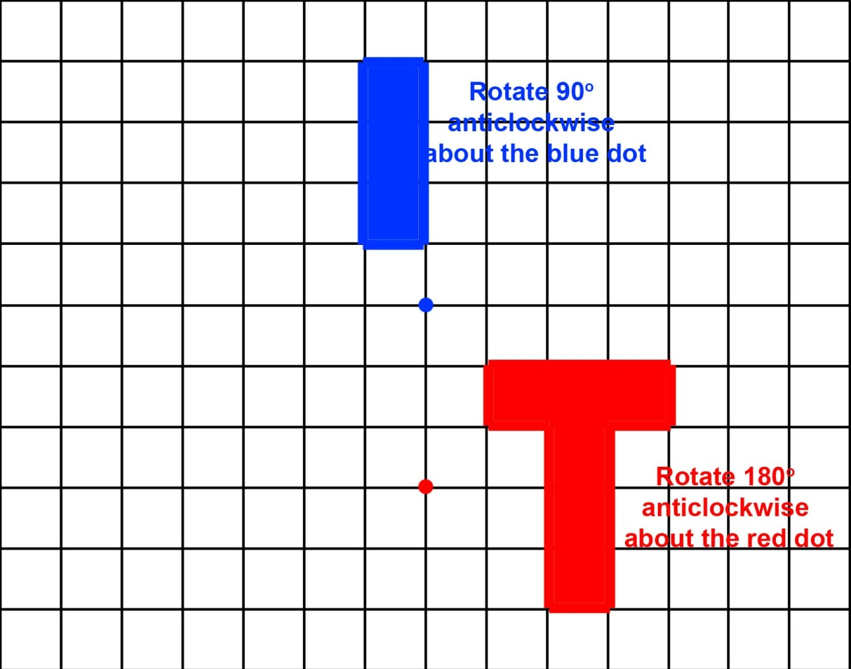
Positive Thinker
Creative Entrepreneur
Independent Learner
Reflective Learner
Responsible Citizen
Team Worker
ROTATIONS
Enterprise Skills
Which ones are you using?
PLENARY ACTIVITY
Which letter would you get if you rotated each shape as described?

Slide 24


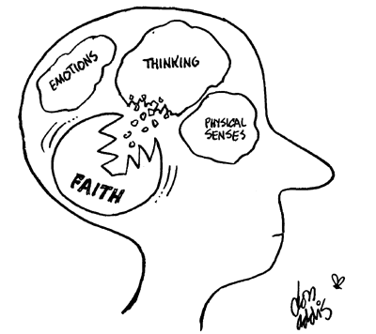
Positive Thinker
Creative Entrepreneur
Independent Learner
Reflective Learner
Responsible Citizen
Team Worker
SELF ASSESSMENT
Enterprise Skills
Which ones are you using?
What have you learnt?
Draw your brain
In your brain, write or draw everything you can remember about rotating objects about different centres of rotation. It can be a skill or a reflection, or something else that might be prominent in your brain.
Where are we in our journey?
What level are we working at?

Slide 25



Positive Thinker
Creative Entrepreneur
Independent Learner
Reflective Learner
Responsible Citizen
Team Worker
SELF ASSESSMENT
Enterprise Skills
Which ones are you using?
Plenary Activity
How well do you understand the task?
.
I don’t understand
I nearly understand
I fully understand

Slide 26



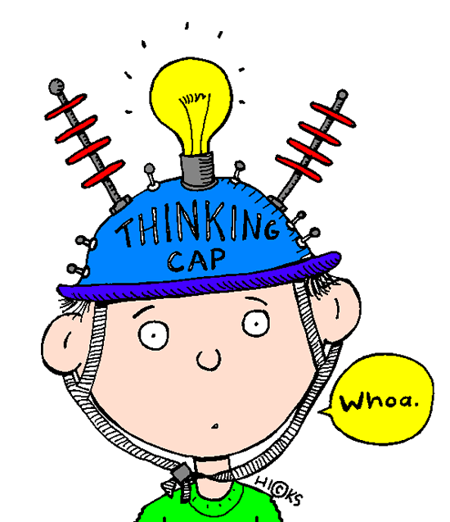
Positive Thinker
Creative Entrepreneur
Independent Learner
Reflective Learner
Responsible Citizen
Team Worker
SELF ASSESSMENT
Enterprise Skills
Which ones are you using?
Plenary Activity
WWW (What Went Well)
EBI (Even Better If)
On your post it notes…
Think about how you can improve your work.

Slide 27
Positive Thinker
Creative Entrepreneur
Independent Learner
Reflective Learner
Responsible Citizen
Team Worker
ROTATIONS
Enterprise Skills
Which ones are you using?
TASK 1 (LEVEL 5)
1)
2)
3)
4)
5)
6)
Rotate the shape 270° clockwise

Slide 28
Positive Thinker
Creative Entrepreneur
Independent Learner
Reflective Learner
Responsible Citizen
Team Worker
ROTATIONS
Enterprise Skills
Which ones are you using?
EXTENSION 1 (LEVEL 5)
1)
2)
3)
4)
5)
6)
Rotate the shape 270° clockwise

Slide 29
Positive Thinker
Creative Entrepreneur
Independent Learner
Reflective Learner
Responsible Citizen
Team Worker
ROTATIONS
Enterprise Skills
Which ones are you using?
TASK 2 (LEVEL 6)
1)
2)
3)
Rotate the shapes from the points given:

Slide 30
Positive Thinker
Creative Entrepreneur
Independent Learner
Reflective Learner
Responsible Citizen
Team Worker
ROTATIONS
Enterprise Skills
Which ones are you using?
TASK 2 (LEVEL 6)
4)
5)
6)
Rotate the shapes from the points given:

Slide 31
Positive Thinker
Creative Entrepreneur
Independent Learner
Reflective Learner
Responsible Citizen
Team Worker
ROTATIONS
Enterprise Skills
Which ones are you using?
EXTENSION 2 (LEVEL 6)
1)
2)
3)
Rotate the shapes from the points given:

Slide 32
Positive Thinker
Creative Entrepreneur
Independent Learner
Reflective Learner
Responsible Citizen
Team Worker
ROTATIONS
Enterprise Skills
Which ones are you using?
EXTENSION 2 (LEVEL 6)
4)
5)
6)
Rotate the shapes from the points given:

Slide 33
Positive Thinker
Creative Entrepreneur
Independent Learner
Reflective Learner
Responsible Citizen
Team Worker
ROTATIONS
Enterprise Skills
Which ones are you using?
TASK 3 (LEVEL 6)
1)
2)
3)
4
A
A
A
2
x
B
x
x
-4
-2
2
4
-2
B
B
-4
4)
5)
6)
A
B
A
A
A
x
x
x
B
B
Rotate the shapes from the points given:

Slide 34
Positive Thinker
Creative Entrepreneur
Independent Learner
Reflective Learner
Responsible Citizen
Team Worker
ROTATIONS
Enterprise Skills
Which ones are you using?
EXTENSION 3 (LEVEL 6)
1)
2)
3)
Plot the co-ordinates (1,-2), (0,2), (3,2) and (3,-3) to make a shape. Rotate this shape 90° clockwise about the origin.
Plot the co-ordinates (2,0), (1,3) and (5,0) to make a shape. Rotate this shape 180° about the origin.
Plot the co-ordinates
(-1,2), (-2,0), (-4,0) and (-3,4) to make a shape. Rotate this shape 270° anti-clockwise about the origin.

Slide 35
Positive Thinker
Creative Entrepreneur
Independent Learner
Reflective Learner
Responsible Citizen
Team Worker
ROTATIONS
Enterprise Skills
Which ones are you using?
PLENARY ACTIVITY
Which letter would you get if you rotated each shape as described?

Slide 36
Positive Thinker
Creative Entrepreneur
Independent Learner
Reflective Learner
Responsible Citizen
Team Worker
ROTATIONS
Enterprise Skills
Which ones are you using?
PLENARY ACTIVITY
Which letter would you get if you rotated each shape as described?

